Slide 1
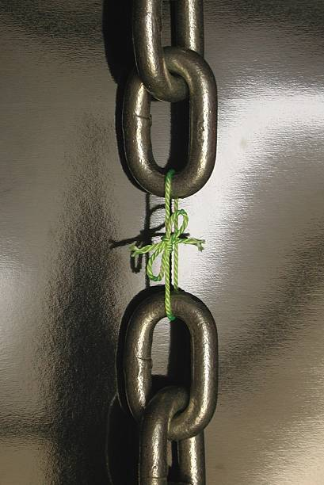
Evolution:
Fallacies
&
Weaknesses
Notes:
(Dan 5). Babylon was considered impregnable because it was surrounded by a great marsh fed from the Euphrates. No one living within its walls thought it was possible for their city to fall. But when the Medes/Persians decided to conquer it, they didn’t besiege the city, but instead rerouted the Euphrates River several miles upstream. The water level then dropped where it allowed them to get under the gates where they took Babylon in secret in just one night. The rumor is that the common people in the city didn’t even know the city had changed hands to the Medes/Persians for 3 weeks. How did it happen?
Belshazzar, the son of Nebuchadnezzar, was holding a huge party that night, as puffed up as he could be. And God caused writing to appear on the wall. Daniel was then summoned to interpret the writing, which in Dan 5:25, in essence read, “You’ve been numbered, you’ve been weighed, and you’ve been found deficient – your kingdom is going to be handed over to your enemy.”
I’m bringing up this story because it reminds me in a lot of ways of Darwinian Evolution. Based on the way it is sort of forced down our throats by the media and school system, you would think that it is such an overwhelming force to be reckoned with, with evidence so strong that none would dare to contend with it, that it makes what we’re attempting to do in these lectures an exercise of futility. This couldn’t be further from the truth.
Darwinian Evolution has certainly gotten hold of many minds/hearts, but studies are showing it is starting to wane in its dominance. Why? Because of the mounting evidence against it and because more and more Creationists are beginning to use the information age to their advantage in educating the masses regarding its many faults and weaknesses as the undeniable strength of the Christian position
So this lesson is designed to encourage you not to be intimidated. The fallacies and weaknesses of the evolutionary worldview are so apparent, so vast, we should show no hesitation whatsoever in joining the front lines in helping to do away w/this scandal once and for all.

Slide 2
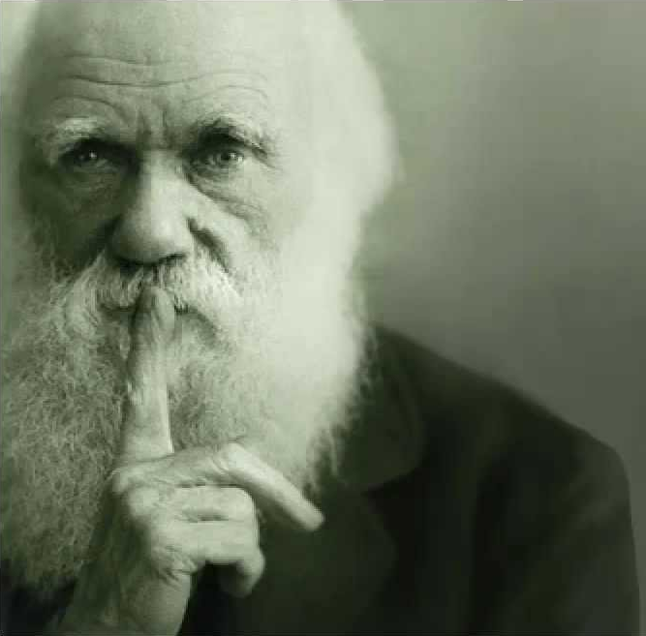
Darwin Saw Weakness
No fossil record transitions
“Why is not every geological formation charged with such links? Why does not every collection of fossil remains afford plain evidence of the gradation and mutation of the forms of life? We meet with no such evidence, and this is the most obvious and forcible of the many objections which may be urged against my theory.” (Origin of Species, ed.1, p. 463.)
Notes:
If you didn’t know it already, this might surprise you. Even Darwin saw weaknesses in his own theories. In fact, he mentions 4 of these theories in his own book, “On the Origin of Species”
First, he readily admits there is a lack of transitional forms seen in the fossil record, saying, “Why is not every geological formation charged with such links? Why does not every collection of fossil remains afford plain evidence of the gradation and mutation of the forms of life? We meet with no such evidence, and this is the most obvious and forcible of the many objections which may be urged against my theory.”
In other words, “I have this theory, this hypothesis, which I believe, but when we dig down into the Earth and look around, we don’t find all these intermediary species to prove my hypothesis.” That was 150 years ago and with all the digging we’ve done, guess how many transitional fossils have been found? 0

Slide 3
Darwin Saw Weakness
No fossil record transitions
Unusual organ complexity
“To say that the eye…could have been formed by natural selection, seems, I freely confess, absurd in the highest possible degree.” (Origin of Species, J.M. Dent & Sons Ltd, London, 1971, p. 167.)
Notes:
Secondly, he admits there is enormous complexity in organs that would appear to lean far more toward intelligent design than natural selection, saying, “To say that the eye…could have been formed by natural selection, seems, I freely confess, absurd in the highest possible degree.”
In other words, “Even a rational thinker has a hard time postulating that something as immensely and inherently complex as the eye could have randomly assembled itself, by chance, to perform all the tasks it does.” We’d agree.
We’ll look at the eye in a bit more detail later.

Slide 4
Darwin Saw Weakness
No fossil record transitions
Unusual organ complexity
Refined instinct in nature
“Can instincts be acquired and modified through natural selection? What shall we say to so marvelous an instinct as that which leads the bee to make cells, which have practically anticipated the discoveries of profound mathematicians?” (Origin of Species, 1st ed. London 1859, pp. 171-172. )
Notes:
Third, he observed that certain species showed such profound instinctual behavior, that the information that forms this instinct would be hard to prove from natural selection, saying, “Can instincts be acquired and modified through natural selection? What shall we say to so marvelous an instinct as that which leads the bee to make cells, which have practically anticipated the discoveries of profound mathematicians?”
In other words, can we say that natural processes are smarter than the most intelligent of mathematicians? Would this not mean there is a mind at work in nature making these selections? This serves the Creationist worldview better than Evolutionists’ worldview.

Slide 5
Darwin Saw Weakness
No fossil record transitions
Unusual organ complexity
Refined instinct in nature
Sterile offspring in breeding
“How can we account for species, when crossed, being sterile and producing sterile offspring, whereas, when varieties are crossed, their fertility is unimpaired?” (Origin of Species, 1st ed. London 1859, pp. 171-172. )
Notes:
And fourth, he fully admits the striking contrast between trying to breed “species”, or what we’d call “kinds” as the bible defines them, and “varieties” within that species/kind (hybridism), saying, “How can we account for species, when crossed, being sterile and producing sterile offspring, whereas, when varieties are crossed, their fertility is unimpaired?”
In other words, the sterility of the crossed offspring and the fertility of the varieties in that species seems to crush his theory altogether.
So, this begs the following question: if these 4 weaknesses are as strong as they appear to be, why would he then continue to propagate his evolutionary hypothesize despite them, when he had no evidence to squash them? And why would others take his literature and use it as their explanation for origins when these weaknesses were so evident not only at the time, but even more evident today with the lack thereof of such evidence?
Well, that was then. The weaknesses for Darwinian Evolution were and continue to be vast. So let’s talk about what they are in detail

Slide 6
Not Scientifically Testable
Scientific Method
Macroevolution
Observation
Observation
Notes:
We cannot do this with Darwinian Evolution, Macroevolution, because it does not meet the criteria for the Scientific Method created by Frances Bacon (a Creationist). What is the scientific method?
First, it starts with an observation of some event in the universe. What did Darwin observe? Darwin observed finches and other different kinds of animals in the world, right? And he saw changes within certain species that got him wondering about origins. But as we discussed in the last lesson, he did not observe molecules to man evolution (macroevolution), he merely observed changes within kinds, what is called microevolution. So while his observation may have begun a nice scientific study of microevolution, it was never an observation of macroevolution. Why? Because according to these scientists, macroevolution occurred slowly over the course of 4.5 billion years and no one was around to see it.

Slide 7
Not Scientifically Testable
Scientific Method
Macroevolution
Observation
Observation
Hypothesis
Hypothesis
Notes:
Yet, he insisted on micro to man evolution and so he developed a hypothesis to explain the event. What was Darwin’s hypothesis? His hypothesis was that all life evolved from a single cell organism, what is called Macroevolution or “Molecules to Man” evolution.
Now some will argue, “No one was around to see it.” And my response is, “Then why are we calling this science?” Understand? Is the moon made of green cheese? It sometimes has a greenish tint, it has holes that they say are craters but it looks like holes in swiss cheese to me. I like cheese, it’d be nice to know that that much quantity of cheese existed in the universe so we could be sure we’d never run out. As ridicules as that sounds, its still a hypothesis right? But is a hypothesis the same things as science? No.

Slide 8
Not Scientifically Testable
Scientific Method
Macroevolution
Observation
Observation
Hypothesis
Hypothesis
Experiment
Experiment
Notes:
After this must come an experiment in order to try and prove the hypothesis. But what are you going to do to prove that a microbe evolved into a man? You could go into a lab and try to show it, but they say, “That took too much time, we can’t do that”. Well than why do you continue to call it a science?
As we saw in the last lesson, they’ve been able to take single celled bacteria and produce a new generation in just 7 to 20 minutes. That’s 4 to 11 years to produce the same number of generations, 300,000, which they claim took the orangutan to become a human. And you know what they find as they do that? Bacteria begets bacteria begets bacteria. No beneficial, persistent mutations that produce new information. We cannot duplicate macroevolution from simple celled organizations, but can we even fathom a number for how much more complex our human bodies are compared to bacteria?

Slide 9
Not Scientifically Testable
Scientific Method
Macroevolution
Observation
Observation
Hypothesis
Hypothesis
Experiment
Experiment
Repeatable
Repeatable
Notes:
But even if there was something we experimented on that seemed to indicate macroevolution, it still couldn’t be considered scientific unless it was repeatable. Not under observational science, not according to the scientific method.

Slide 10
Not Scientifically Testable
Scientific Method
Macroevolution
Observation
Observation
Hypothesis
Hypothesis
Experiment
Experiment
Repeatable
Repeatable
Falsifiable
Falsifiable
Notes:
But then finally, and to me this is the biggest one, evolution is not scientific because it is not falsifiable. What this means is that for something to be scientifically confirmed, you have to be able to run negative controls, meaning run the experiment in reverse, to get negative results. If an assertion can be falsified, it is assumed to be true. But if is not, its not scientific…it’s merely conjecture, an idea.
Example: Cyanide consumption will kill rabbits. That is a hypothesis. Is that scientifically testable? Is it scientifically falsifiable? Yes, by putting sugar in the water instead of cyanide, you make it falsifiable.
Evolution is not and cannot be falsifiable because of how long ago it supposedly happened. So why are we still calling it science? It has to pass every single one of these steps, but it fails every single one of them.

Slide 11
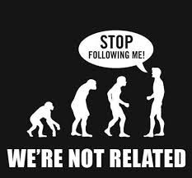
Not Scientifically Testable
Theodosius Dobzhansky – “It is manifestly impossible to reproduce in the laboratory the evolution of man…these evolutionary happenings are unique, unrepeatable, and irreversible…experimental evolution deals of necessity with only the simplest levels of the evolutionary process, sometimes called microevolution.” (American Scientist, December 1957).
L.H. Matthews – “In accepting evolution as fact, how many biologists pause to reflect that science is built upon theories that have been proved by experiment to be correct or remember that the theory of animal evolution has never been thus proved?...Is it then science of faith?” ("Introduction," Origin of Species, Charles Darwin, 1971 edition)
Notes:
Now interestingly, Evolutionary scientists have admitted it is not science in round about ways:
Theodosius Dobzhansky, the guy who pioneered the modern evolutionary synthesis in Biology w/fruit flies, who believed in and created the modern gene mutation theory of evolution (Neo-Darwinism), said “It is manifestly impossible to reproduce in the laboratory the evolution of man…” and then he lists some other animals. Then he followed it up with, “These evolutionary happenings are unique, unrepeatable, and irreversible…experimental evolution deals of necessity with only the simplest levels of the evolutionary process, sometimes called microevolution.”
Well that’s what we believe! That’s what Creationists believe. It’s what we see in Genesis when Jacob was breeding Laban’s sheep, and some were spotted and others speckled, but they were all sheep?
L. H. Matthews, the Evolutionists who was allowed to write the introduction of Darwin’s Origin of Species, said, “In accepting evolution as fact, how many biologists pause to reflect that science is built upon theories that have been proved by experiment to be correct or remember that the theory of animal evolution has never been thus approved?“ He said later, “Is it then a science or faith?” —L.H. Matthews, "Introduction," Origin of Species, Charles Darwin (1971 edition).

Slide 12
Not Scientifically Testable
Charles Birch & Paul Ehrlich – “Our theory of evolution has become, as Popper described, one which cannot be refuted by any possible observations. Every conceivable observation can be fitted into it. It is thus outside of empirical science but not necessarily false. No one can think of ways in which to test it.” (Evolutionary history and population biology, Nature, 214:352, 1967)
Dr. Wolfgang Smith – “The point, however, is that the doctrine of evolution has swept the world, not on the strength of its scientific merits, but precisely in its capacity as a Gnostic myth. It affirms, in effect, that living beings create themselves, which is, in essence, a metaphysical claim. This in itself implies, however, that the theory is scientifically unverifiable (a fact, incidentally, which has often enough been pointed out by philosophers of science). Thus, in the final analysis, evolutionism is in truth metaphysical doctrine decked out in scientific garb.” (Teilhardism and the New Religion, Rockford, Illinois: Tan Books and Publishers, 1988, p. 242)
Notes:
Notice what Evolutionists Charles Birch and Paul Ehrlich said in Nature magazine. Nature magazine is one of the most prestigious scientific journals in the world, and people spend their whole careers trying to get published in this journal.
“Our theory of evolution has become, as Popper described, one which cannot be refuted by any possible observations. Every conceivable observation can be fitted into it. It is thus outside of empirical science but not necessarily false. No one can think of ways in which to test it.”
In other words, you say whatever you want, but evolution can never be proven wrong. Why? Because it’s a hypothesis, a philosophy, a worldview, but it is absolutely not science.
Dr. Wolfgang Smith, a math professor at MIT, is an opponent of Darwinian Evolution and advocates for Intelligent Design – “The point, however, is that the doctrine of evolution has swept the world, not on the strength of its scientific merits, but precisely in its capacity as a Gnostic myth. It affirms, in effect, that living beings create themselves, which is, in essence, a metaphysical claim. This in itself implies, however, that the theory is scientifically unverifiable (a fact, incidentally, which has often enough been pointed out by philosophers of science). Thus, in the final analysis, evolutionism is in truth metaphysical doctrine decked out in scientific garb.”
What does he mean by metaphysics? What is metaphysics? Its not physical, its above physical, its spiritual, which means it’s a religion. It means Evolutionists have faith just like other religions have faith.

Slide 13
Not Scientifically Testable
S. L. Washburn – “The behaviors that led to the origin of man are not available for study, and must be reconstructed from fragmentary fossils, the anatomy and behaviors of contemporary primates, but there is wide area for disagreements. Doctrines which seemed certain in one decade may crumble under the impact of new discoveries, new methods of dating, new experiments. Under these circumstances, it may be more useful to regard the study of evolution as a game rather than as a science. Uncertainties are far greater than might be thought from reading scientific papers and, in spite of the emphasis on evolutionary theory, there is no agreement on the rules of the evolutionary game.” (Study of Evolution—More of a Game Than a Science, Abstracts, 71st Annual Meeting, Washington, D.C.: American Anthropological Association, 1972, p. 121)
Notes:
Sherwood Washburn, a Harvard graduate and Anthropologist who has taught at Columbia University, University of Chicago, and the University of California at Berkley:
“The behaviors that led to the origin of man are not available for study, and must be reconstructed from fragmentary fossils, the anatomy and behaviors of contemporary primates, but there is wide area for disagreements. Doctrines which seemed certain in one decade may crumble under the impact of new discoveries, new methods of dating, new experiments. Under these circumstances, it may be more useful to regard the study of evolution as a game rather than as a science. Uncertainties are far greater than might be thought from reading scientific papers and, in spite of the emphasis on evolutionary theory, there is no agreement on the rules of the evolutionary game.”
We should not be interested in what is possible. There are as many possibilities as the imagination can muster. We must go after that which is plausible based on actual evidence.

Slide 14
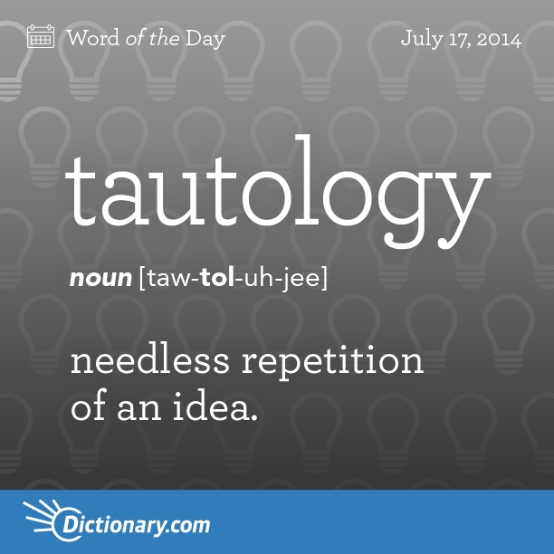
Tautology
Survival of the Fittest
“Which animals survive?”
“Those that are most fit.”
“What do you mean by ‘most fit’?”
“Those that survive.”
“But why do they survive and others don’t?”
“Based on their fitness.”
“And what determines fitness?”
“Their propensity for survival.”
“And what determines this ability?”
“Their environmental suitability.”
Notes:
Secondly, Evolution is actually based on “tautology”. That’s a fancy name for the logical fallacy we sometimes call circular reasoning – an unnecessary, needless repetition of meaning using dissimilar words that effectively say the same thing twice. It is a circular statement such as “deafness causes loss of hearing”—while it is true, it adds nothing to our understanding.
What is an example? As Darwin observed nature, he thought it to be a very hostile place where there was an overproduction of animals and a limited supply of food. His belief was that this caused a bloody struggle for existence among animals in which only the most fit survive. And so natural selection came to be further defined as “survival of the fittest”. But one of the problems with this “explanation” is that it is a tautology. Why? Because if you ask the question, “Which animals survive?”, they’ll answer something like “Those that are most fit”. “Well what do we mean by ‘most fit’”? “Those that survive.” “Well how do they survive and others don’t?” “Based on their fitness”. “And what determines this fitness” “Their propensity to survive”. “And what this determines this propensity?” “Their environmental suitability”.
See how I said things differently, but they were really just the same thing? Darwinian Evolutionists do this all the time. And if you don’t recognize the circular reasoning, the tautology, you’ll sit there scratching your head wondering if the reason you don’t get this is maybe because you’re just too stupid when in reality the ones that do this either can’t explain it themselves and are just repeating what they’ve heard, or they’re being deliberately dishonest.
Now, interestingly enough, when Neo-Darwinism came along in the 1950s, they started relabeling “survival of the fittest” as “differential reproduction”. This view suggests that nature doesn’t merely select from the fittest of animals, but from animals that leave the most offspring. And yet this whole mess started with Darwin suggesting the entire reason for Evolution is animals leaving too many offspring because there isn’t enough food for them to eat. Now we are told by Neo-Darwinists that the animals that leave the most offspring insure the continued survival of their species. Go figure. Add to that the fact that Neo-Darwinists like Paul Ehrlich (that we quoted earlier) staunchly insist that we humans must strictly limit the number of our offspring if our species is to survive. They can’t even get their theories straight and so around and around they go.

Slide 15
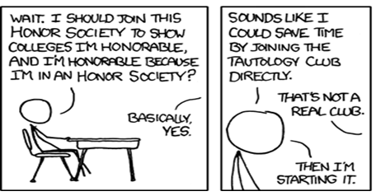
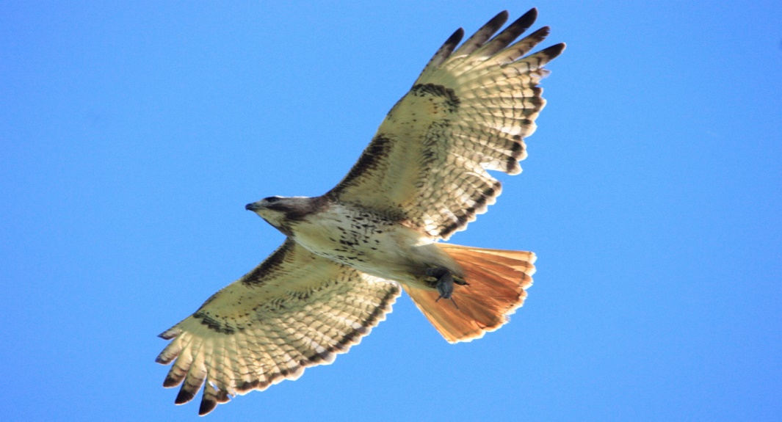
Tautology
“Survival of the Fittest”
“Survival of the Survivors”
Notes:
The story is told of a student walking to school who saw in the grass a mouse that remained absolutely motionless as a hawk soared overhead. When she asked her teacher why, the teacher explained that mice which ran were seen and killed by the hawk, so natural selection produced those which remained motionless. The next day, the student saw a mouse running to its burrow as a hawk soared overhead. When she asked her teacher why, the teacher explained how mice that remained motionless were easy targets for the sharp-eyed hawk that killed and ate them, so natural selection favored the mice which ran.
See, the reason why Evolutionists love “survival of the fittest” is because what it really amounts to is “survival of the survivors” – its tautology that can explain anything: why mice run or why they stay put, why some species, like the horseshoe crabs, never changed in “600 million years” while others changed rapidly and quickly (e.g., an insect-eater thought to have evolved into horses, whales, and bats in less than “5 million years”). The so-called “proof” that natural selection produced evolution is too often merely the argument that survivors survived.

Slide 16
Tautology
Dating The Fossil Record
“How do you date fossils?” (Sunderland)
“By the Cambrian rocks in which they were found.” (Fisher)
“Is this not circular reasoning?” (Sunderland)
“Of course, how else are you going to do it?” (Fisher) (Bible Science Newsletter, Dec 1986, p. 6.)
J. E. O’Rourke – “The rocks do date the fossils, but the fossils date the rocks more accurately. Stratigraphy cannot avoid this kind of reasoning…because circularity is inherent in the derivation of time scales.” (Pragmatism vs. Materialism in Stratigraphy, American Journal of science, January 1976.)
David Raup – “The charge that the construction of the geologic scale involves circularity has a certain amount of validity.” (Geology and Creationism, Field Museum of Natural History Bulletin, March 1983, p. 21.)
Notes:
Darwinian geologists admit that this circular reasoning exists as a fundamental pillar of geological faith. For example, in a 1979 interview with Dr. Donald Fisher, the state paleontologist for New York, Luther Sunderland, asked him:
"How do you date fossils?"
His reply: "By the Cambrian rocks in which they were found."
Sunderland then asked him if this were not circular reasoning.
Fisher replied, "Of course, how else are you going to do it?" (Bible Science Newsletter, December 1986, p. 6.)
“The rocks do date the fossils, but the fossils date the rocks more accurately. Stratigraphy cannot avoid this kind of reasoning…because circularity is inherent in the derivation of time scales."—*J.E. O'Rourke, "Pragmatism vs. Materialism in Stratigraphy," American Journal of science, January 1976.
The paleontology director of the Field Museum in Chicago admits the problem exists.
“The charge that the construction of the geologic scale involves circularity has a certain amount of validity."—*David M. Raup, "Geology and Creationism," Field Museum of Natural History Bulletin, March 1983, p. 21.

Slide 17
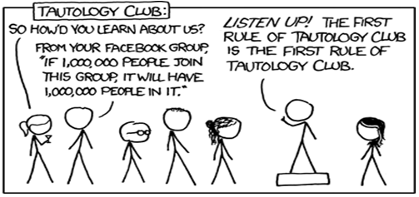
Tautology
Gregory Alan Peseley – “One of the most frequent objections against the theory of natural selection is that it is a sophisticated tautology. Most evolutionary biologists seem unconcerned about the charge and make only a token effort to explain the tautology away. The remainder, such as Professors Waddington and Simpson, will simply concede the fact. For them, natural selection is a tautology which states a heretofore unrecognized relation: the fittest—defined as those who will leave the most offspring—will leave the most offspring.”
“What is most unsettling is that some evolutionary biologists have no qualms about proposing tautologies as explanations. One would immediately reject any lexicographer who tried to define a word by the same word, or a thinker who merely restated his proposition, or any other instance of gross redundancy; yet no one seems scandalized that men of science should be satisfied with a major principle which is no more than a tautology (“The Epistemological Status of Natural Selection,” Laval Theologique et Philosophique, v. XXXVIII, February 1982, p. 74.)
Notes:
The Frenchman Gregory Alan Peseley, a philosophy professor, said this – “One of the most frequent objections against the theory of natural selection is that it is a sophisticated tautology. Most evolutionary biologists seem unconcerned about the charge and make only a token effort to explain the tautology away. The remainder, such as Professors Waddington and Simpson, will simply concede the fact. For them, natural selection is a tautology which states a heretofore unrecognized relation: the fittest—defined as those who will leave the most offspring—will leave the most offspring.”
“What is most unsettling is that some evolutionary biologists have no qualms about proposing tautologies as explanations. One would immediately reject any lexicographer who tried to define a word by the same word, or a thinker who merely restated his proposition, or any other instance of gross redundancy; yet no one seems scandalized that men of science should be satisfied with a major principle which is no more than a tautology.

Slide 18
Tautology
Arthur Koestler – “Once upon a time, it all looked so simple. Nature rewarded the fit with the carrot of survival and punished the unfit with the stick of extinction. The trouble only started when it came to defining fitness...Thus natural selection looks after the survival and reproduction of the fittest, and the fittest are those which have the highest rate of reproduction...We are caught in a circular argument which completely begs the question of what makes evolution evolve.”
“In the meantime, the educated public continues to believe that Darwin has provided all the relevant answers by the magic formula of random mutations plus natural selection—quite unaware of the fact that random mutations turned out to be irrelevant and natural selection a tautology”. (Janus: A Summing Up, 1978, p. 170)
Notes:
Vitalist philosopher Arthur Koestler observed – “Once upon a time, it all looked so simple. Nature rewarded the fit with the carrot of survival and punished the unfit with the stick of extinction. The trouble only started when it came to defining fitness...Thus natural selection looks after the survival and reproduction of the fittest, and the fittest are those which have the highest rate of reproduction...We are caught in a circular argument which completely begs the question of what makes evolution evolve”
“In the meantime, the educated public continues to believe that Darwin has provided all the relevant answers by the magic formula of random mutations plus natural selection—quite unaware of the fact that random mutations turned out to be irrelevant and natural selection a tautology” (Janus: A Summing Up, 1978, p. 170)

Slide 19
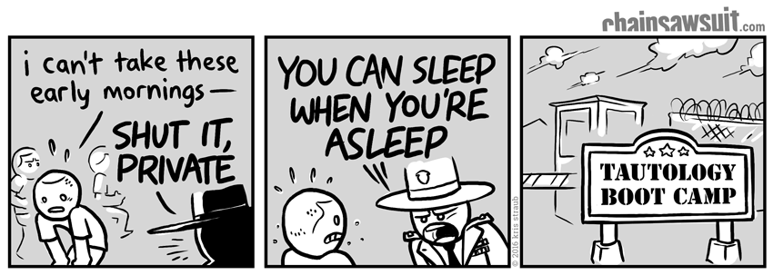
Tautology
Douglas Futuyma – “Is the hypothesis of natural selection falsifiable or is it a tautology? The claim that natural selection is a tautology is periodically made in the scientific literature itself.” (Dr. Douglas J. Futuyma, Science on Trial, New York: Pantheon Books, 1983, p. 171)
R.H. Peters – “I argue that the ‘theory of evolution’ does not make predictions, so far as ecology is concerned, but is instead a logical formula which can be used only to classify empiricisms [theories] and to show the relationships which such a classification implies. These theories are actually tautologies and, as such, cannot make empirically testable predictions. They are not scientific theories at all.” (Tautology in Evolution and Ecology, American Naturalist , 1976, Vol. 110, No. 1, p. 1)
Notes:
Douglas Futuyma, one of the premier writers of biology textbooks on Evolution, said – “Is the hypothesis of natural selection falsifiable or is it a tautology?…The claim that natural selection is a tautology is periodically made in the scientific literature itself.” (Dr. Douglas J. Futuyma, Science on Trial, New York: Pantheon Books, 1983, p. 171)
Professor of Ecology R.H. Peters from Canada's McGill University – “I argue that the ‘theory of evolution’ does not make predictions, so far as ecology is concerned, but is instead a logical formula which can be used only to classify empiricisms [theories] and to show the relationships which such a classification implies. These theories are actually tautologies and, as such, cannot make empirically testable predictions. They are not scientific theories at all.”
In other words, he’s saying it does not make a prediction which can be tested. If something is scientific, what do you do? You first make a prediction (hypothesis), then you go out and test it. But in Evolution, you cannot make a scientific prediction because you can’t go out and test it. That makes it a philosophy and a faith, not science.
Example – Tom says, “All animals evolve from an original single-celled organism as is evidenced in the geological column.” Bob then asks, “How did all animals evolve from an original single-celled organism?” Tom answers, “By gene mutations and natural selection.” Tom then asks, “How can you be sure that gene mutations or natural selection morphs one kind of mammal into another kind of mammal?” Bob then says, “Because in the fossil column, we see that all animals evolve from an original single-celled organism.”
Arguing with an evolutionist often turns into a circular game where nothing is ever really proven.

Slide 20
Refusal To Debate
Earl Hanson – “Why do Creationists seem to be the consistent winners in public debates with evolutionists…we biologists are our own worst enemies in the creationist-evolutionist controversies. We must no longer duck this and other issues related to biology and human affairs.” (“Evolution/Creation Debate,” Bioscience, Vol. 30, January 1980, pp. 4-5)
Notes:
3rd, there has been an increase in a refusal to debate the issues publically by Evolutionists.
In the 1970s, there was a great wave of debates between Evolutionists and Creationists. And Creationists were destroying Evolutionists in these debates and people were starting to take notice. And given the lack of evidence for the Darwinian evolutionary worldview and the abundant evidence for Creationism, this shouldn’t surprise us.
Earl Hanson, an Evolutionist, said this in 1980 publication of magazine Bioscience – “Why do Creationists seem to be the consistent winners in public debates with evolutionists?...We biologists are our own worst enemies in the creationist-evolutionist controversies. We must no longer duck this and other issues related to biology and human affairs.” (“Evolution/Creation Debate,” Bioscience, Vol. 30, January 1980, pp. 4-5)
So for the next 16 years, throughout the 80s and 90s, there were a bunch of debates with the exact same results. The Evolutionists did not come out on top, and many were in fact converted over to Creationism as a result of these debates.
So as an Evolutionist, what do you do? Step up the rhetoric? Find someone skilled in public debate? Come up with better evidence? What do you do?

Slide 21
Refusal To Debate
Eugenie Scott – “Avoid debates. If your local campus Christian fellowship asks you to ‘defend evolution,’ please decline. Public debates rarely change many minds…”
“Have you ever watched the Harlem Globetrotters play the Washington Federals? The Federals get off some good shots, but who remembers them? The purpose of the game is to see the Globetrotters beat the other team…and you probably will get beaten.” (Monkey Business, The Sciences, Jan/Feb 1996, p 20-25)
Notes:
Well, in 1996, Eugenie Scott, an Evolutionist who has a PHD in Anthropology and is the Executive Director of the National Center for Science Education, Berkeley, California, said the following. You need to know that this woman is the most ardent spokesman in this country for Evolution being taught in school exclusively. Here’s what she said:
“Avoid debates. If your local campus Christian fellowship asks you to ‘defend evolution,’ please decline. Public debates rarely change many minds”
What did she mean by “change many minds”? She’s not taking about Creationists changing their minds because that rarely happens. She’s talking about all the Evolutionists that changed their minds. She then added:
“Have you ever watched the Harlem Globetrotters play the Washington Federals? The Federals get off some good shots, but who remembers them? The purpose of the game is to see the Globetrotters beat the other team…and you probably will get beaten.” (“Monkey Business”, The Sciences, January/February 1996, pp. 20-25)

Slide 22
Refusal To Debate
Henry Morris – “By now, practically every leading evolutionary scientist in this country has declined one or more invitations to a scientific debate on cre­ation/evolution.” (Reason or Rhetoric, by Henry Morris, PhD)
Discovery Institute – “Defenders of Darwin's theory of evolution typically proclaim that evidence for their theory is simply overwhelming. If they really believe that, you would think they would jump at a chance to publicly explain some of that overwhelming evidence to the public. Apparently not.” (http://www.evolutionnews.org/2005/02/are_kansas_evolutionists_afraid_of_a_fai.html)
Notes:
Henry Morris – “By now, practically every leading evolutionary scientist in this country has declined one or more invitations to a scientific debate on cre­ation/evolution.” (Reason or Rhetoric, by Henry Morris, PhD)
In an article entitled Are Kansas Evolutionists Afraid of a Fair Debate? , the Discovery Institute states the following, “Defenders of Darwin's theory of evolution typically proclaim that evidence for their theory is simply overwhelming. If they really believe that, you would think they would jump at a chance to publicly explain some of that overwhelming evidence to the public. Apparently not.”
And now, it is very hard to get a serious debate with an Evolutionist. Even Richard Dawkins, one of the most famous outspoken atheist of our times, has shown inconsistent and deceptive behavior in his refusal to debate creation scientists.

Slide 23
Refusal To Debate
John 3:19-21 – “¹⁹This is the judgment, that the Light has come into the world, and men loved the darkness rather than the Light, for their deeds were evil. ²⁰For everyone who does evil hates the Light, and does not come to the Light for fear that his deeds will be exposed. ²¹But he who practices the truth comes to the Light, so that his deeds may be manifested as having been wrought in God.”
Prov 25:9-10 – “⁹Argue your case with your neighbor, and do not reveal the secret of another, ¹⁰Or he who hears it will reproach you, and the evil report about you will not pass away.”
2 Cor 4:2 – “But we have renounced the things hidden because of shame, not walking in craftiness or adulterating the word of God, but by the manifestation of truth commending ourselves to every man’s conscience in the sight of God.”
Notes:
But as Christians, this shouldn’t surprise us right? What does the bible say about this kind of behavior?
John 3:19-21 – “This is the judgment, that the Light has come into the world, and men loved the darkness rather than the Light, for their deeds were evil. For everyone who does evil hates the Light, and does not come to the Light for fear that his deeds will be exposed. But he who practices the truth comes to the Light, so that his deeds may be manifested as having been wrought in God”
Why, as human beings, is it so easy to hide behind rhetoric, insults, and logical fallacies to justify a position rather than bring it out in the open and let be honestly examined? Because there is something to hide (more on this later). Evolutionists and Creationists have the same evidence. Why not bring that evidence out in the open and let two people who are experts in each field examine that evidence in a public setting? Well, when one of them knows that their position is untrue but doesn’t want to admit it, or feels the evidence is not in favor of his position, he’ll avoid it. And history continues to show that it is evolutionists who are the ones avoiding the debate.
Prov 25:9-10 – “⁹Argue your case with your neighbor, and do not reveal the secret of another, ¹⁰Or he who hears it will reproach you, and the evil report about you will not pass away.”
These verses teach a principle applying both to private and public dispute, that is we should deal with our opponent in an open, honest, and direct way. Otherwise, our motives will be exposed as underhanded, treacherous, and dishonest. Both Jesus and his apostles debated their cause publicly. People who refuse and avoid open examination of their teaching will eventually suffer the disgrace of their actions.
2 Cor 4:2 – “But we have renounced the things hidden because of shame, not walking in craftiness or adulterating the word of God, but by the manifestation of truth commending ourselves to every man’s conscience in the sight of God.”
Why do Creationists want to take this into the public arena? Because we’re not ashamed. We’re not trying to hide anything. Let’s get this out there. We want to take the evidence, take the truth, and commend it to every man’s conscience. In other words, let them decide. Let the masses decide in a fair, open forum which worldview holds more weight.

Slide 24
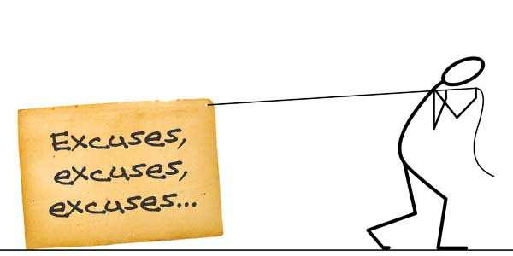
Refusal To Debate
Nick Gotelli – “Academic debate on controversial topics is fine, but those topics need to have a basis in reality. I would not invite a creationist to a debate on campus for the same reason that I would not invite an alchemist, a flat-earther, an astrologer, a psychic, or a Holocaust revisionist. These ideas have no scientific support, and that is why they have all been discarded by credible scholars. Creationism is in the same category.” (http://scienceblogs.com/pharyngula/2009/02/18/how-to-respond-to-requests-to/)
Notes:
Let’s now play devil’s advocate. Some Evolutionists believe they have good reason not to debate Creationists, and I want to share some quotes with you and then analyze what they say:
Nick Gotelli , a professor at the University of Vermont, wrote a letter in 2009 where he explained his refusal to debate an intelligent design advocate. Here is what he said:
“Academic debate on controversial topics is fine, but those topics need to have a basis in reality. I would not invite a creationist to a debate on campus for the same reason that I would not invite an alchemist, a flat-earther, an astrologer, a psychic, or a Holocaust revisionist. These ideas have no scientific support, and that is why they have all been discarded by credible scholars. Creationism is in the same category.”
What’s he doing here? He’s basically presenting Creationists as people unworthy of debate. “They don’t have scientific support, they’re as out of touch as the flat-earthers, just as silly as astrologers, and psychics.” In other, just ad hominum attacks, just excuses.

Slide 25
Refusal To Debate
Eugenie Scott – “This is another reason not to debate creationists: in the scientific community, theories do not rise or fall based on debate and rhetoric, but on the strength of evidence.”
“Since there is no evidence to support a young earth, a sudden creation, or a global flood, one must be prepared for the main rhetorical devices of the creationist: out-of-context quotations and straw-man arguments. Creationists…have raised this tactic to an art form. This works because the audience cannot believe that a “Christian” is going to lie, and nothing the opponent says will convince them otherwise. It is a tremendous waste of time for the scientist to wade through half-truths and urban legends before even touching upon the science.” (Debates, National Center for Science Education)
Notes:
We looked at that Eugenie Scott quote earlier, the anti-creation organization she heads up called “National Center for Science Education” released in one of its editions a report trying to convince evolutionists on why they should not debate Creationists. Here is what it said:
“This is another reason not to debate creationists: in the scientific community, theories do not rise or fall based on debate and rhetoric, but on the strength of evidence.”
We agree with that, right? So let’s stop with the name calling, the ad-hominums, the deflections, the bait and switches, circular reasonings, and lets look at the evidence. But then she says this:
“Since there is no evidence to support a young earth, a sudden creation, or a global flood, one must be prepared for the main rhetorical devices of the creationist: out-of-context quotations and straw-man arguments. Creationists … have raised this tactic to an art form. This works because the audience cannot believe that a “Christian” is going to lie, and nothing the opponent says will convince them otherwise. It is a tremendous waste of time for the scientist to wade through half-truths and urban legends before even touching upon the science.” (Debates, National Center for Science Education)
What do they mean by “lie”? All they mean is that they can’t answer the arguments, so they call them a lie – and then they refuse to debate. So let’s just call names, make accusations, bring into question their character, and then refuse to debate.
Folks, this is the best they’ve got. This is why you just don’t see the public debates like we used to see a generation ago.

Slide 26
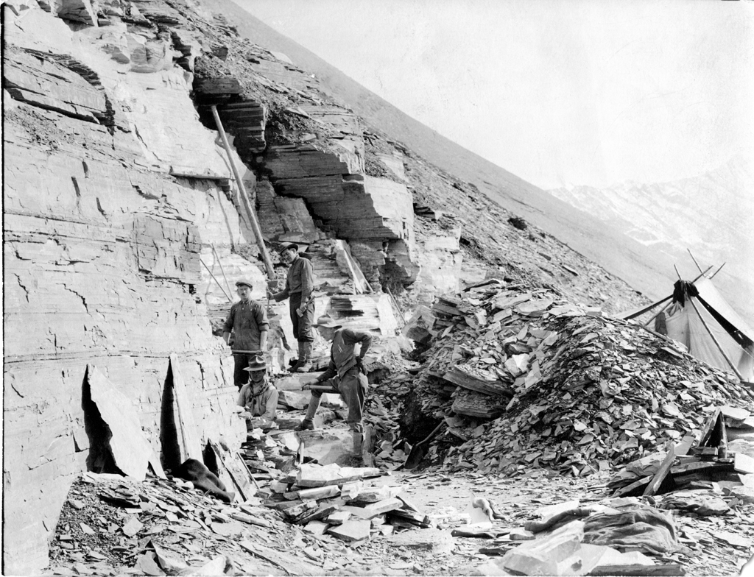
Hiding Evidence
Gerald Schroeder – “Had Walcott wanted, he could have hired a phalanx of graduate students to work on the fossils. But he chose not to rock the boat of evolution. Today fossil representatives of the Cambrian era have been found in China, Africa, the British Isles, Sweden, Greenland. The explosion was worldwide. But before it became proper to discuss the extraordinary nature of the explosion, the data were simply not reported.” (Evolution: Rationality vs. Randomness)
Notes:
Finally, Evolutionists have been hiding evidence for years. We’re going to talk about the fossil record extensively in the coming weeks because it is one of the strongest, if not the strongest, evidence to refute Evolution. Its been estimated that ~100 million fossils have been unearthed in excavations since Darwin’s time, but Darwinists don’t display them in museums. But that is their strategy because it destroys their theory. Let me give you one explain why…
In 1909, there were fossils discovered in Canada’s Burgess Shale region by a paleontologist named Charles Doolittle Walcott. It was 4 years worth of excavation work that uncovered perfect fossils that he claimed were 530 million years old. But he kept them in storage and they were not open to examination until 1985, which was well after his death, some 76 years later. Want to know why? Because they were found in the Cambrian Layer of the geologic column. But according to Evolutionists, that was a period where nothing but single-cells organisms were even supposed to be alive. Instead, it revealed life forms of that time had the same complexity as living things today, and that a great variety of animals emerged at the same time, what we know call the “Cambrian Explosion”. And Walcott knew this was the death nail for Darwinian Evolution so he concealed it.
An Israeli scientist named Gerald Schroeder made this comment on the subject:
“Had Walcott wanted, he could have hired a phalanx of graduate students to work on the fossils. But he chose not to rock the boat of evolution. Today fossil representatives of the Cambrian era have been found in China, Africa, the British Isles, Sweden, Greenland. The explosion was worldwide. But before it became proper to discuss the extraordinary nature of the explosion, the data were simply not reported.” (Evolution: Rationality vs. Randomness)

Slide 27
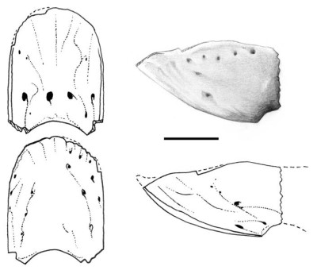
Hiding Evidence
Thomas Stidham – “This find suggests that by the end of the Cretaceous period, around 65 to 70 million years ago, modern birds were an important group, at least in North America…These data also indicate that modern bird groups, including parrots, may have been relatively unaffected by the mass extinction at the end of the Cretaceous period.” (Nature, Nov 5, 1998)
Notes:
This was by no means an isolated event. In 1960, the jawbone of a parrot was found during excavations in Wyoming but Evolutionists kept it in storage for 40 years. That is, until a researcher from University of Berkley in California decided to investigate it – his name was Thomas Stidham. The jawbone of this parrot was found in the Cretaceous period of the geologic column. What is significant about that? This period, according to Evolutionists, was supposed to have been from 65 million years ago, when dinosaurs existed.
Where were birds supposed to have evolved from? Dinosaurs. What did they find that was living at the same time as dinosaurs? Parrots.
X-ray scans of this fossil showed a “K”-shaped feature on the fossil that constituted blood vessel and nerve pathways that is identical to that in modern-day parrots.
“This find suggests that by the end of the Cretaceous period, around 65 to 70 million years ago, modern birds were an important group, at least in North America…These data also indicate that modern bird groups, including parrots, may have been relatively unaffected by the mass extinction at the end of the Cretaceous period.” (Nature, Nov 5, 1998)

Slide 28
Notes:
As more fossils in storage are uncovered, Evolutionists will continue to lose credibility. Until then, though, remember Luke 12:2 – “But there is nothing covered up that will not be revealed, and hidden that will not be known.”

